Slide 1
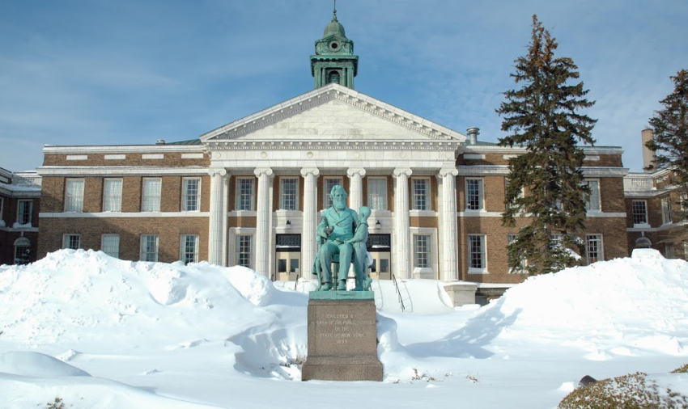
November 24, 2014
Faculty Assembly
Academic Affairs Update

Slide 2
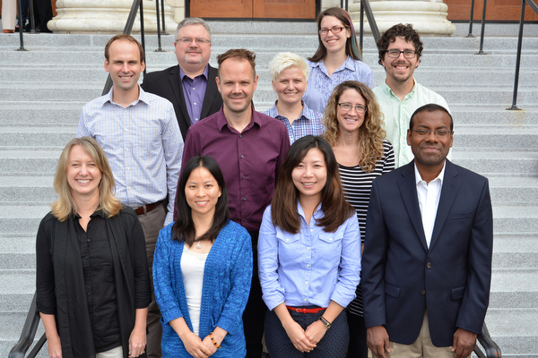
Completed Searches 2014
TT Faculty Hires for 2014-15
Replacement TT Faculty (28) —New TT Faculty (3)
Diversity increased by 18% with these hires
Dean, CLAS (Adrienne McCormick, Ph.D.)
Assoc. Prov. for Research Development & Admin. (Bill Bowers, Ph.D.)
Director of Center for Experiential Learning (Denise DiRienzo)
Student Success Specialists (Michelle Kent & Daniel Lupa)
Asst. Provost for Special Projects-“First in the World” (Karen Valentino)
Quest Coordinator (Norm Weiner)

Slide 3
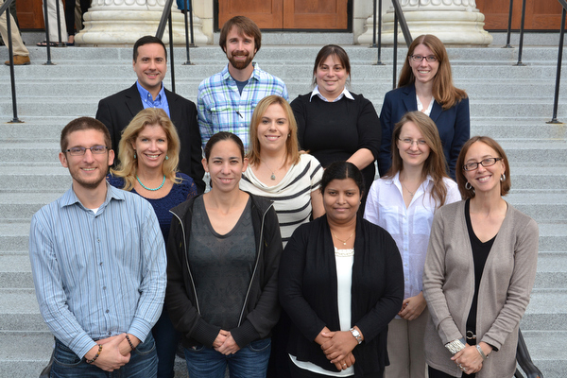
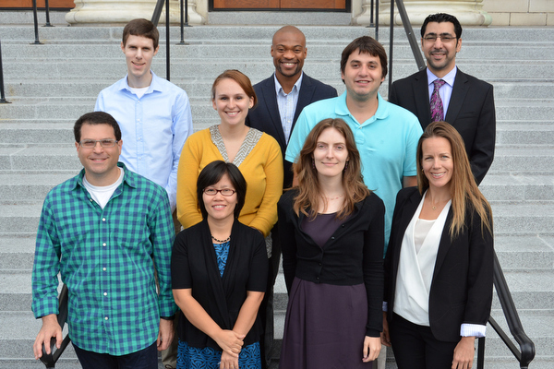
Searches During 2014-15
Dean, SCMA
14 Replacement Faculty TT searches
2 New TT search
— 1 Grant Funded
Associate Director, OIEP
Associate Dean, SOB

Slide 4
SUNY High-Needs Grants Awarded:
Supporting Faculty Costs:
Bio Health Informatics Faculty $85,000, renewable
Wireless Lab Director
$183,000, 3-yr step down

Slide 5
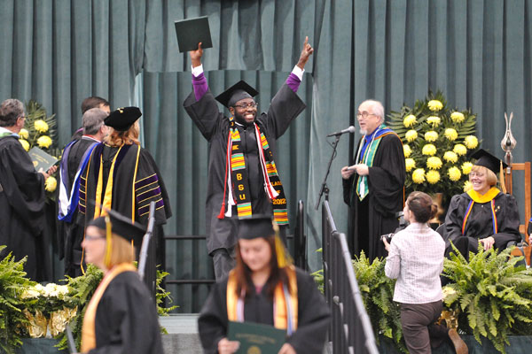
Open SUNY Programs
MBA (2013)
MBA/Health Services (2013)
Health and Wellness Graduate Certificate (2014)

Slide 6
Online Program Self-Study
Institutional Readiness Plan:
Best Practices
Technology support
Faculty support/workshops
Rubrics course quality/refresh
Closing the Gaps
Remote proctoring high stakes testing
Disseminate distance learning policies
Online student community
Recruitment/retention part-time online students

Slide 7
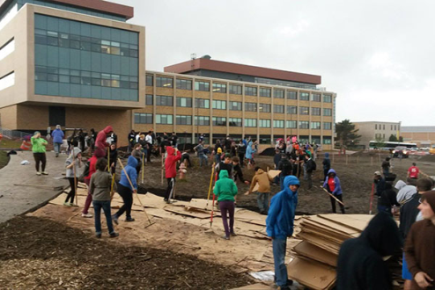
New Centers/Labs Launched
Active Aging and Community Engagement Center
Advanced Wireless Systems Research (ADWISR) Center
Permaculture Living Lab
International Professional Achievement Academy
Arts and Humanities Center (in development)

Slide 8
Center for Experiential Learning
New Director & reorganization of staff roles & responsibilities
Strategic Priorities
Develop a clearing house of opportunities/info for students & faculty
Easy access for increased participation
Faculty advisory board
Improve quality/variety of experiences

Slide 9
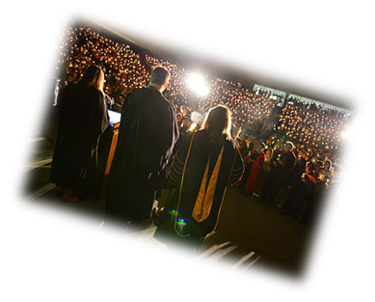
Transfer Student Success
Corie Kohlbach and Mary Ann Preston will be meeting w/ depts. to review data on transfer student success
Depts. to align courses/identify problem areas for students and share w/community colleges

Slide 10
International Student Success
Identified contact person for international student support—Ebru Altay Damkaci
English for Academic Purposes (EAP)
Gurdeep Skolnik
Review of campus internationalization efforts and OIEP services
Student satisfaction
Faculty and Staff barometer

Slide 11
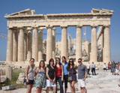
International Opportunities Expanded
16 New Agreements Signed
5.5% increase in Study Abroad
236 International Students Enrolled in Oswego Fall’14
6 new COIL Courses developed
New SUNY Diversity Abroad Honors Scholarship Program
Get Go Scholarships
EC English Program (non-credit)

Slide 12
Roadmap for Comprehensive Internationalization
Conducting inventory on current study abroad offerings
Work to offer across curriculum in a scheduled approach
Ongoing discussions with departments this academic year

Slide 13
New Testing Services
Proctored and Make-Up Exams through Extended Learning
SUNY Oswego Students (no charge)
Non-SUNY Oswego Students ($20 fee)
Locations: Main Campus, Phoenix, Metro Center
www.oswego.edu/testingservices

Slide 14
Accreditation/Assessment Updates
NCATE Reaccreditation- no findings!!
MSCHE Progress Report
Program Assessment
SLOAN Quality Scorecard—Online

Slide 15
Winter Sessions—2014
Winter – 2,734 Credits Earned

Slide 16
First Annual SUNY Undergraduate Research Conference (SURC)
The conference be held on April 10, 2015 from 9:30 am-5:30 pm at The College at Brockport
SURC is a multidisciplinary, annual spring semester event that will be hosted each year by a different SUNY institution. It brings together undergraduate student researchers and faculty mentors from across the SUNY system for a full day of activities:
Student presentations (oral and poster), performances, and artistic displays
Luncheon and keynote
SUNY Graduate School Fair
Workshops on career development for students
Workshops on government and SUNY research grants for faculty
Abstracts describing students’ scholarly and/or creative projects must be submitted by February 1, 2015.
For more information go to www.suny.edu/SURC

Slide 17
External Support Continues to Grow
12.5% increase in external support and sponsored research
2013-14 $4.3M Academic Affairs
$2.9M First in the World Grant

Slide 18
First in the World Grant
Transfer Student Collaborative with MVCC, CCC, OCC, On Point for College
Student Cohort
First generation college students
Under-represented
Low income
Key Program Components
Course alignment
Dual enrollments, articulations & passports
Transfer course
Transfer ambassadors
Discipline based campus activities
New Hires
9-10 new professional hires
2-3 Graduate Assistants
1 full-time secretary
Advisory Committee

Slide 19
Discretionary Salary Awards
Notification of DSA award via e-mail by the end of next week
Award will be in paycheck dated December 17th
Full-time awards—approximately $550 and $350
Part-time awards—approximately $500 and $300

Slide 20
Thank you Best wishes for a Happy Thanksgiving!

